Slide 1




A Comparative Deuteration Survey of Starless Cores
Hannah Gruber
Advised by: Yancy Shirley
University of Arizona
Arizona Space Grant Symposium
Tucson, AZ April 20th 2024

Slide 2
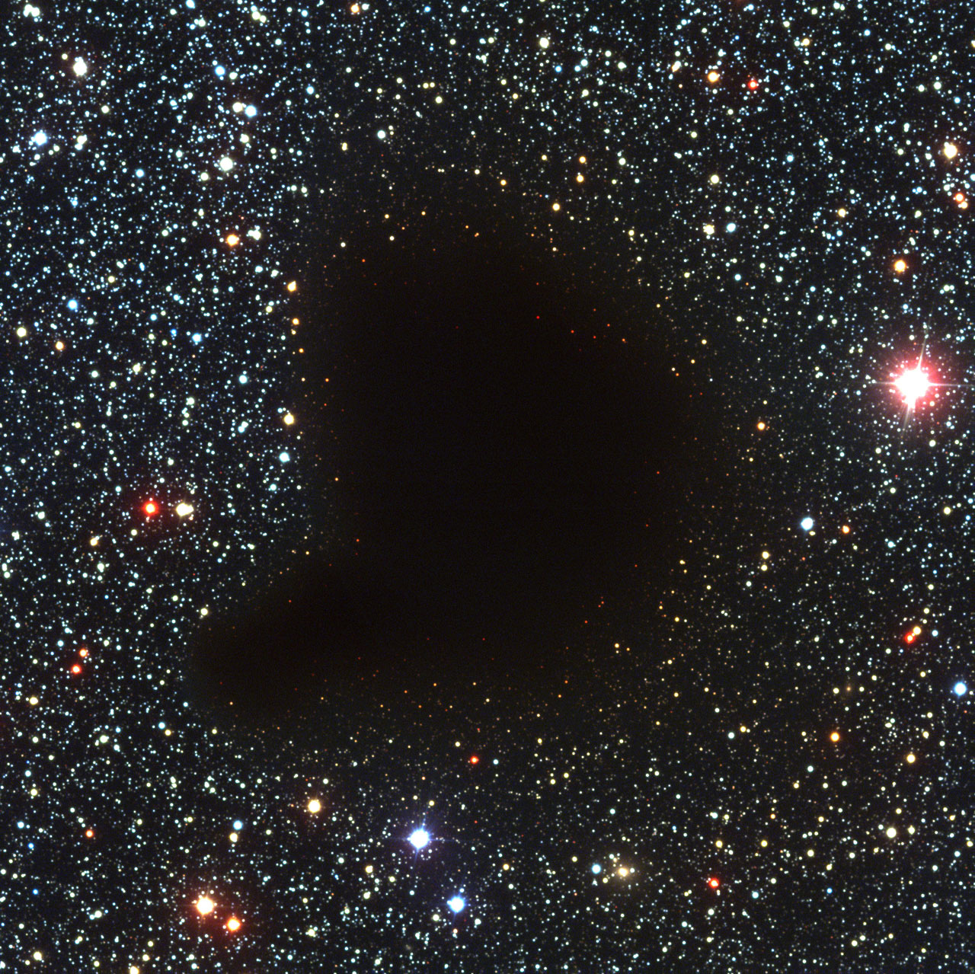
What is a starless core?
Dense core of gas and dust within a molecular cloud
Initial state of star formation
Credit: European Southern Observatory

Slide 3
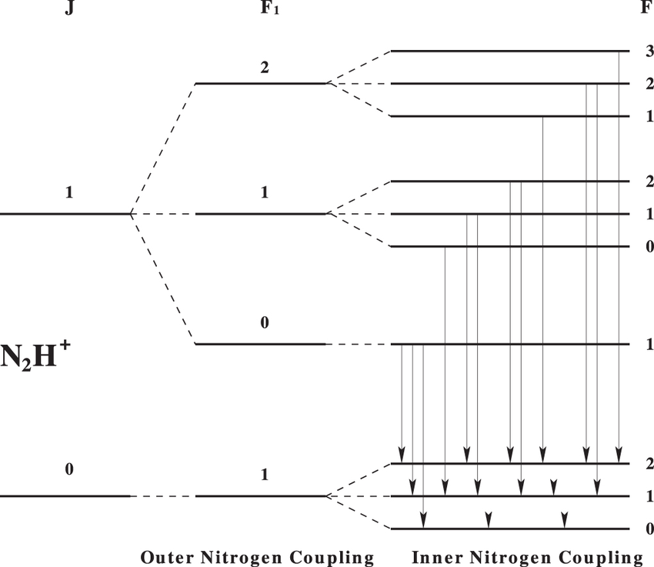
Molecular spectroscopy: the study of starless cores
Gas and dust emission – how we learn about starless cores
Molecules have rotational energy transitions observable in radio
Credit: Jeff Magnum, Yancy Shirley (2015)

Slide 4
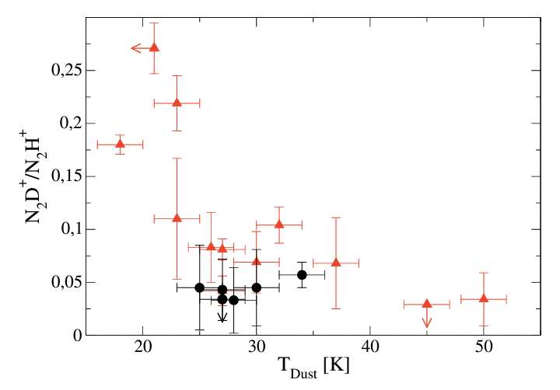
What is deuteration?
Typical ratio of 10⁻⁵ with atomic Hydrogen
Molecular deuterium fraction increases in cold (<10K) environments
Can be used as an indicator of core evolution
Credit: M. Emprechtinger, et al (2009)

Slide 5
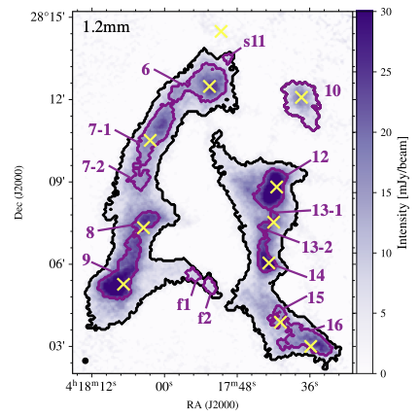
B10 Survey
Survey of 12 starless cores within the Taurus Molecular Cloud (~135pc away)
Has been modeled by Scibelli et al (2023)
Pristine environment to study evolution

Slide 6
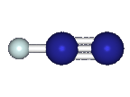
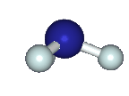
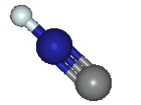
Molecules observed
Focus on dense gas tracers
Observations taken of both deuterated and non-deuterated molecules for comparison
Multiple transitions observed
N₂H⁺ / N₂D⁺
oNH₃ / oNH₂D, pNH₃ / pNH₂D
HNC / DNC, HN¹³C / DN¹³C
Credit: astrochymist.org

Slide 7
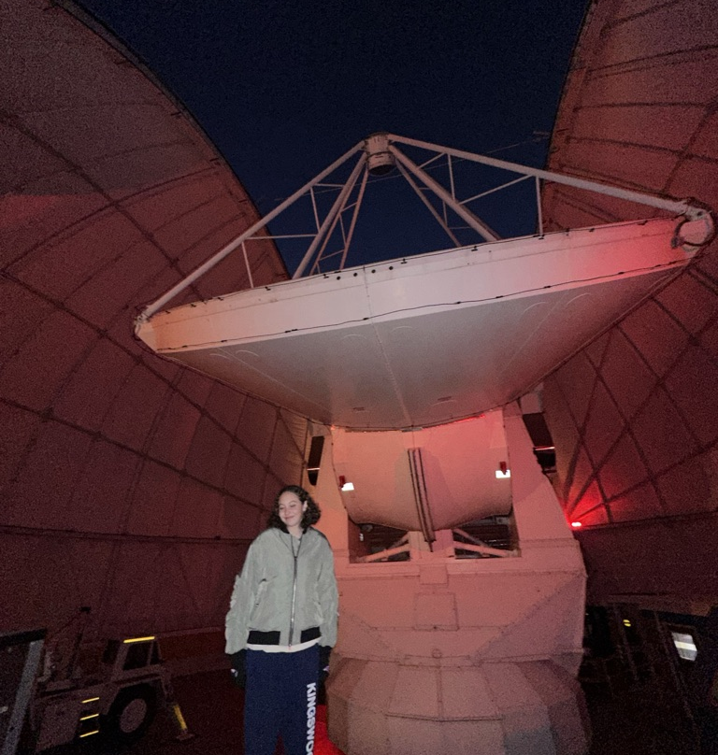
12m Radio Telescope – Kitt Peak, AZ Arizona Radio Observatory

Slide 8
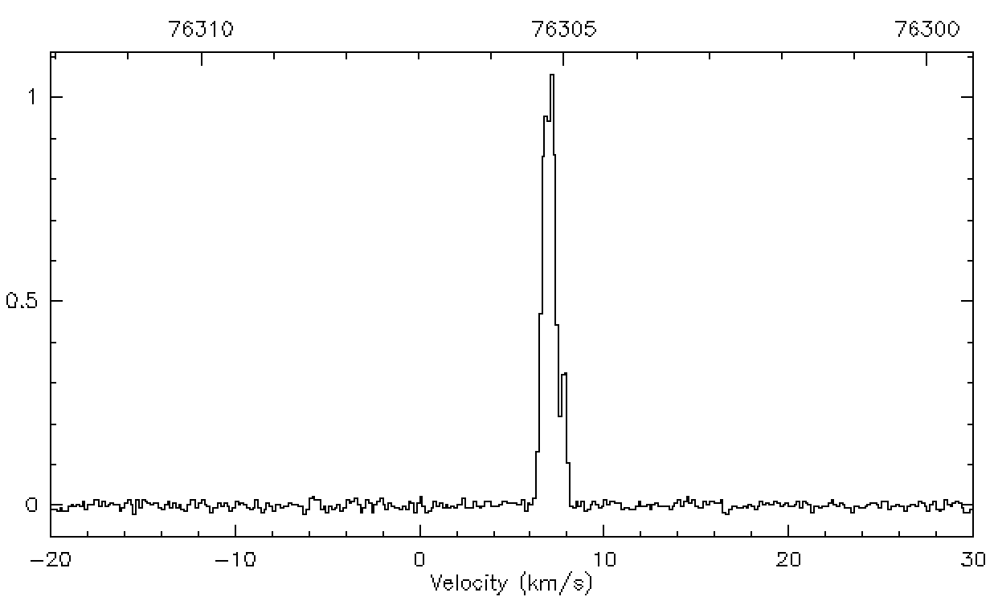
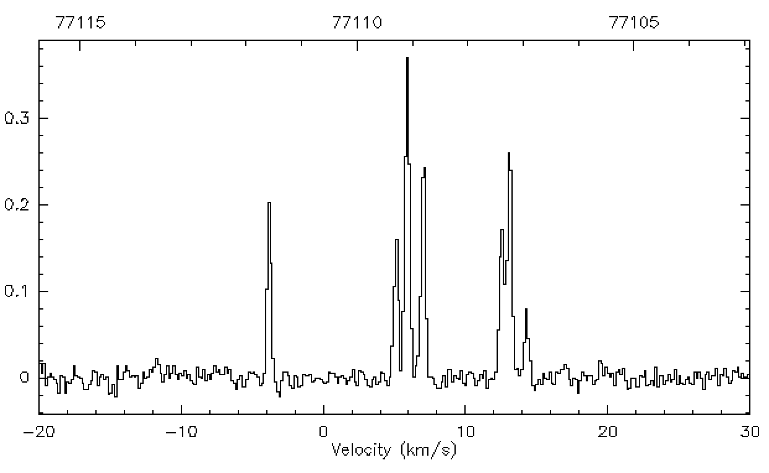
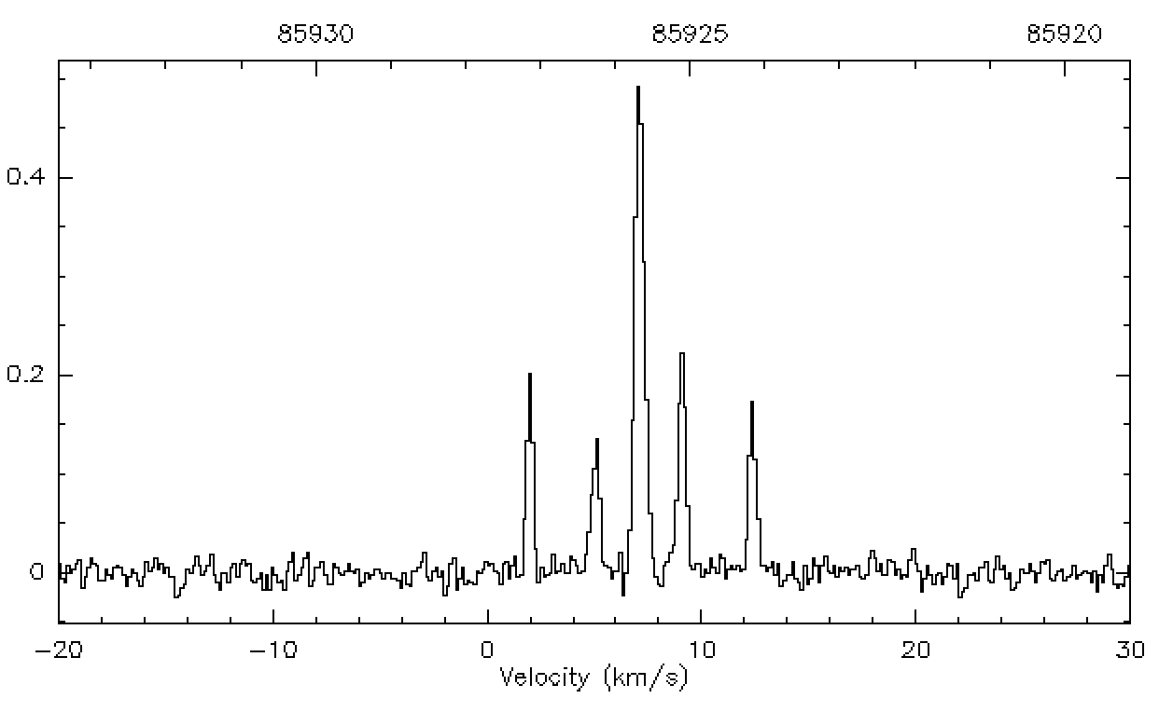
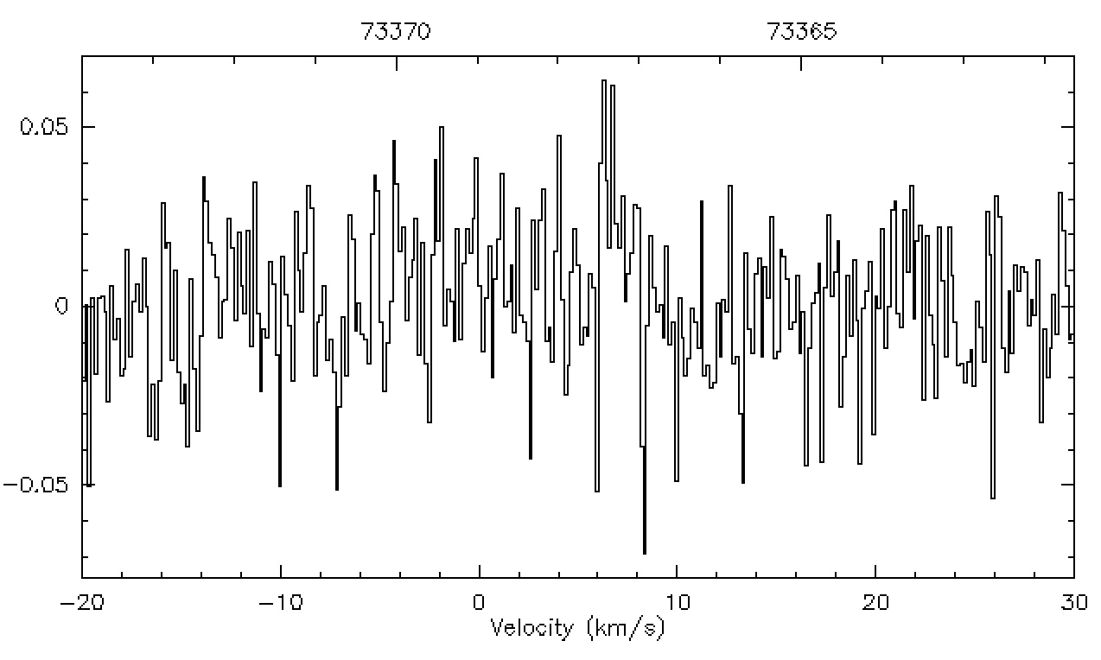
Observations of Seo09
N₂DP 1-0
DNC 1-0
oNH₂D –
86 GHz
DN¹³C – 73 GHz

Slide 9
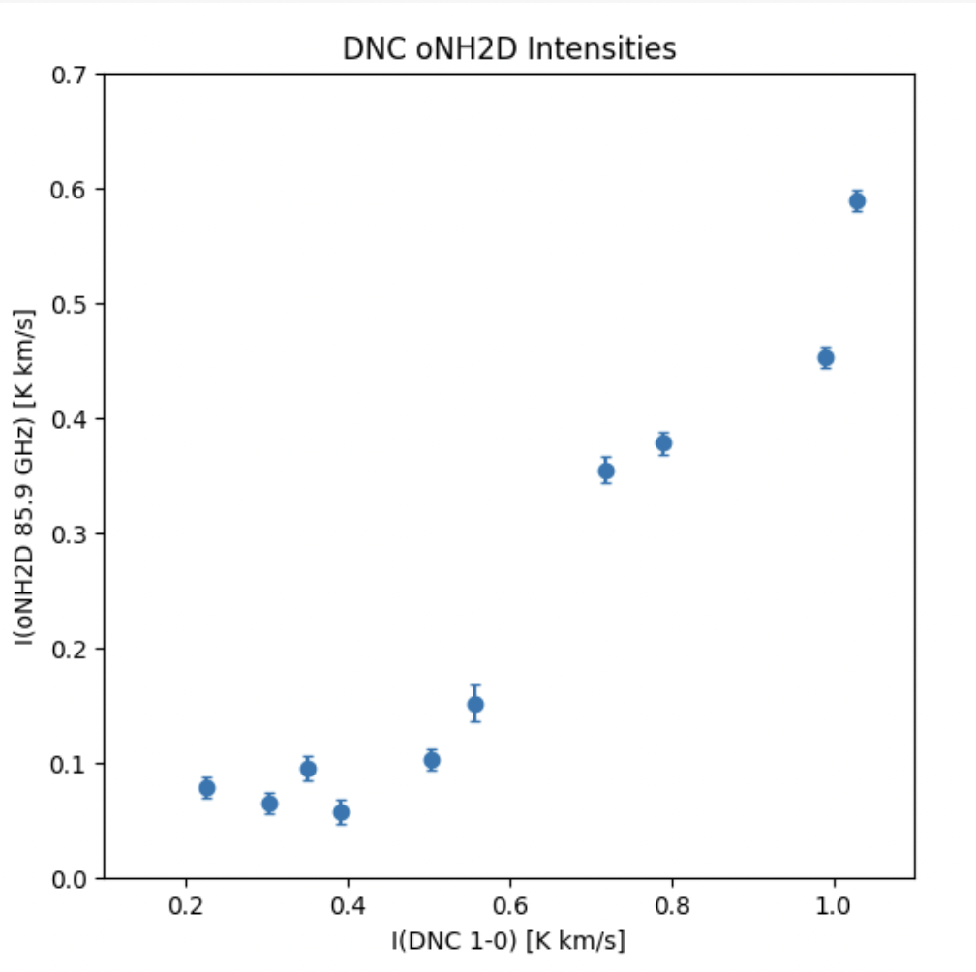
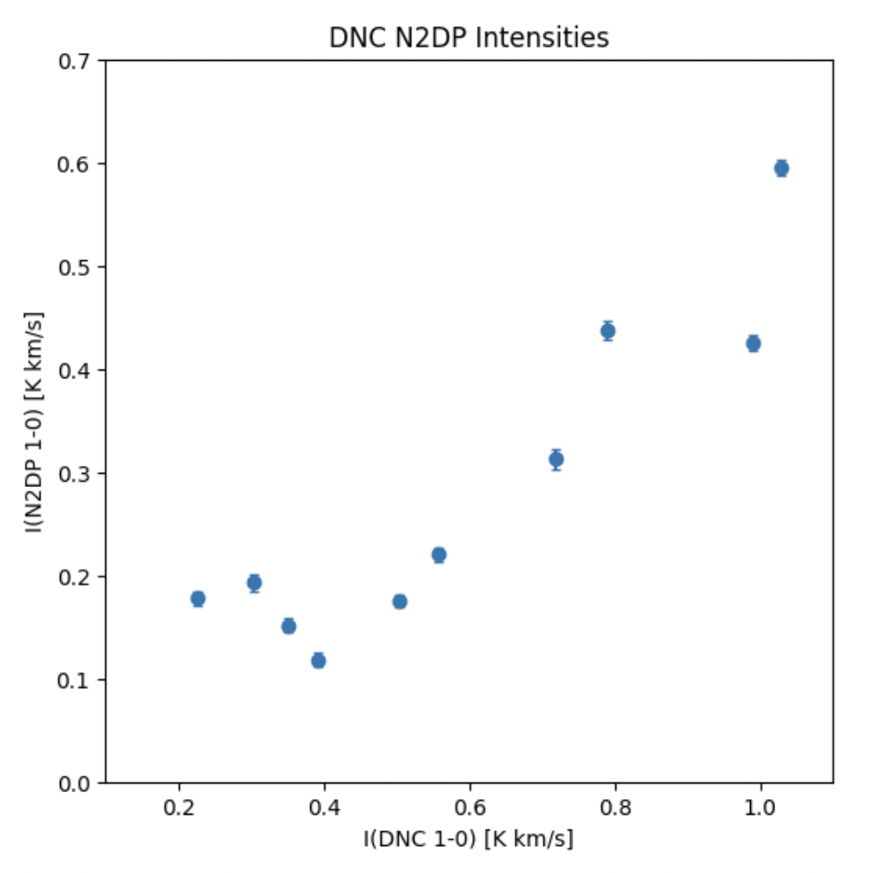
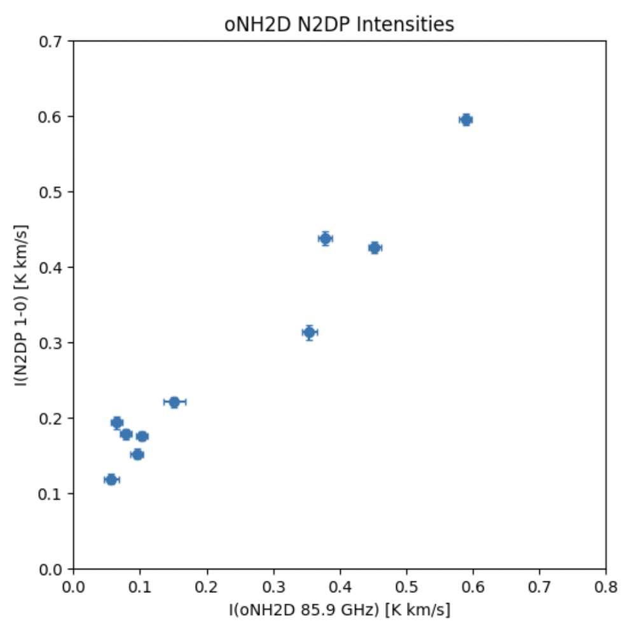
Intensity Comparisons
DNC/oNH₂D
DNC/N₂DP
oNH₂D/N₂DP
oNH₂D intensity
N₂DP intensity
N₂DP intensity
DNC intensity
DNC intensity
oNH₂D intensity
Positive correlation between different molecules
Still a lot of work to be done!

Slide 10
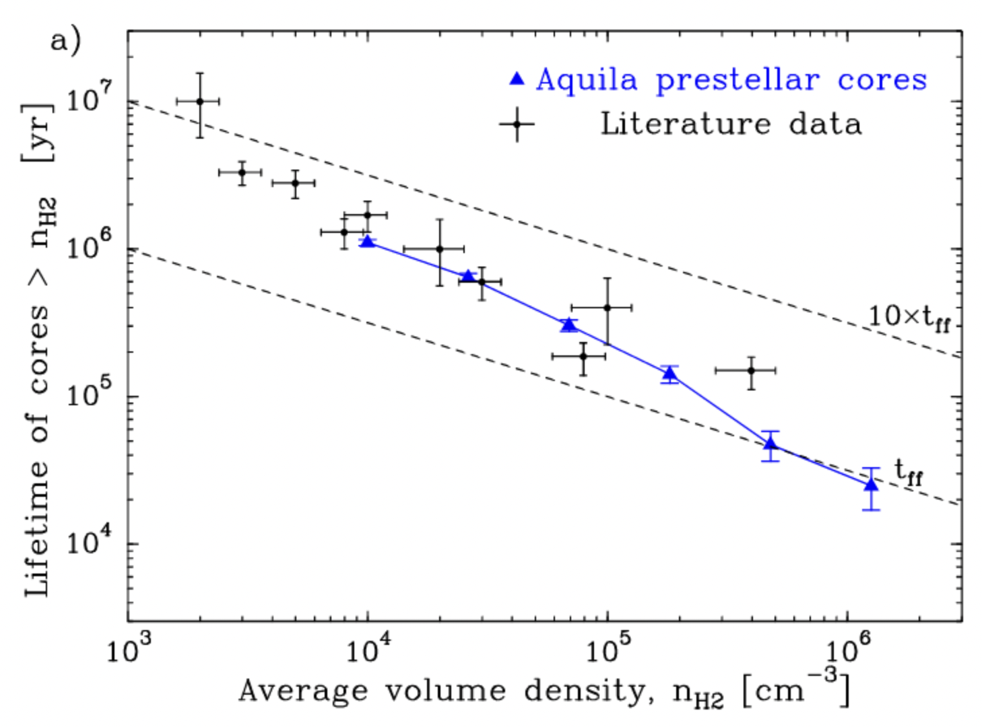
Future plans
Calculate column densities, leading to abundance ratios
Graph against physical parameters
Possible comparison to existing models of chemical evolution
Credit: P. André, et al (2013)

Slide 11
Acknowledgements
Thank you to my advisor Yancy Shirley for your mentorship and sticking with me through several projects and their iterations. Thank you to the NASA Space Grant Program for offering me the opportunity to conduct and present my research at this level. Thank you to Aurora Wilde and Hanga Andras-Letanovszky for your support and guidance as a part of my research group. Thank you to the University of Arizona for offering me these opportunities and hosting this conference!

Slide 12
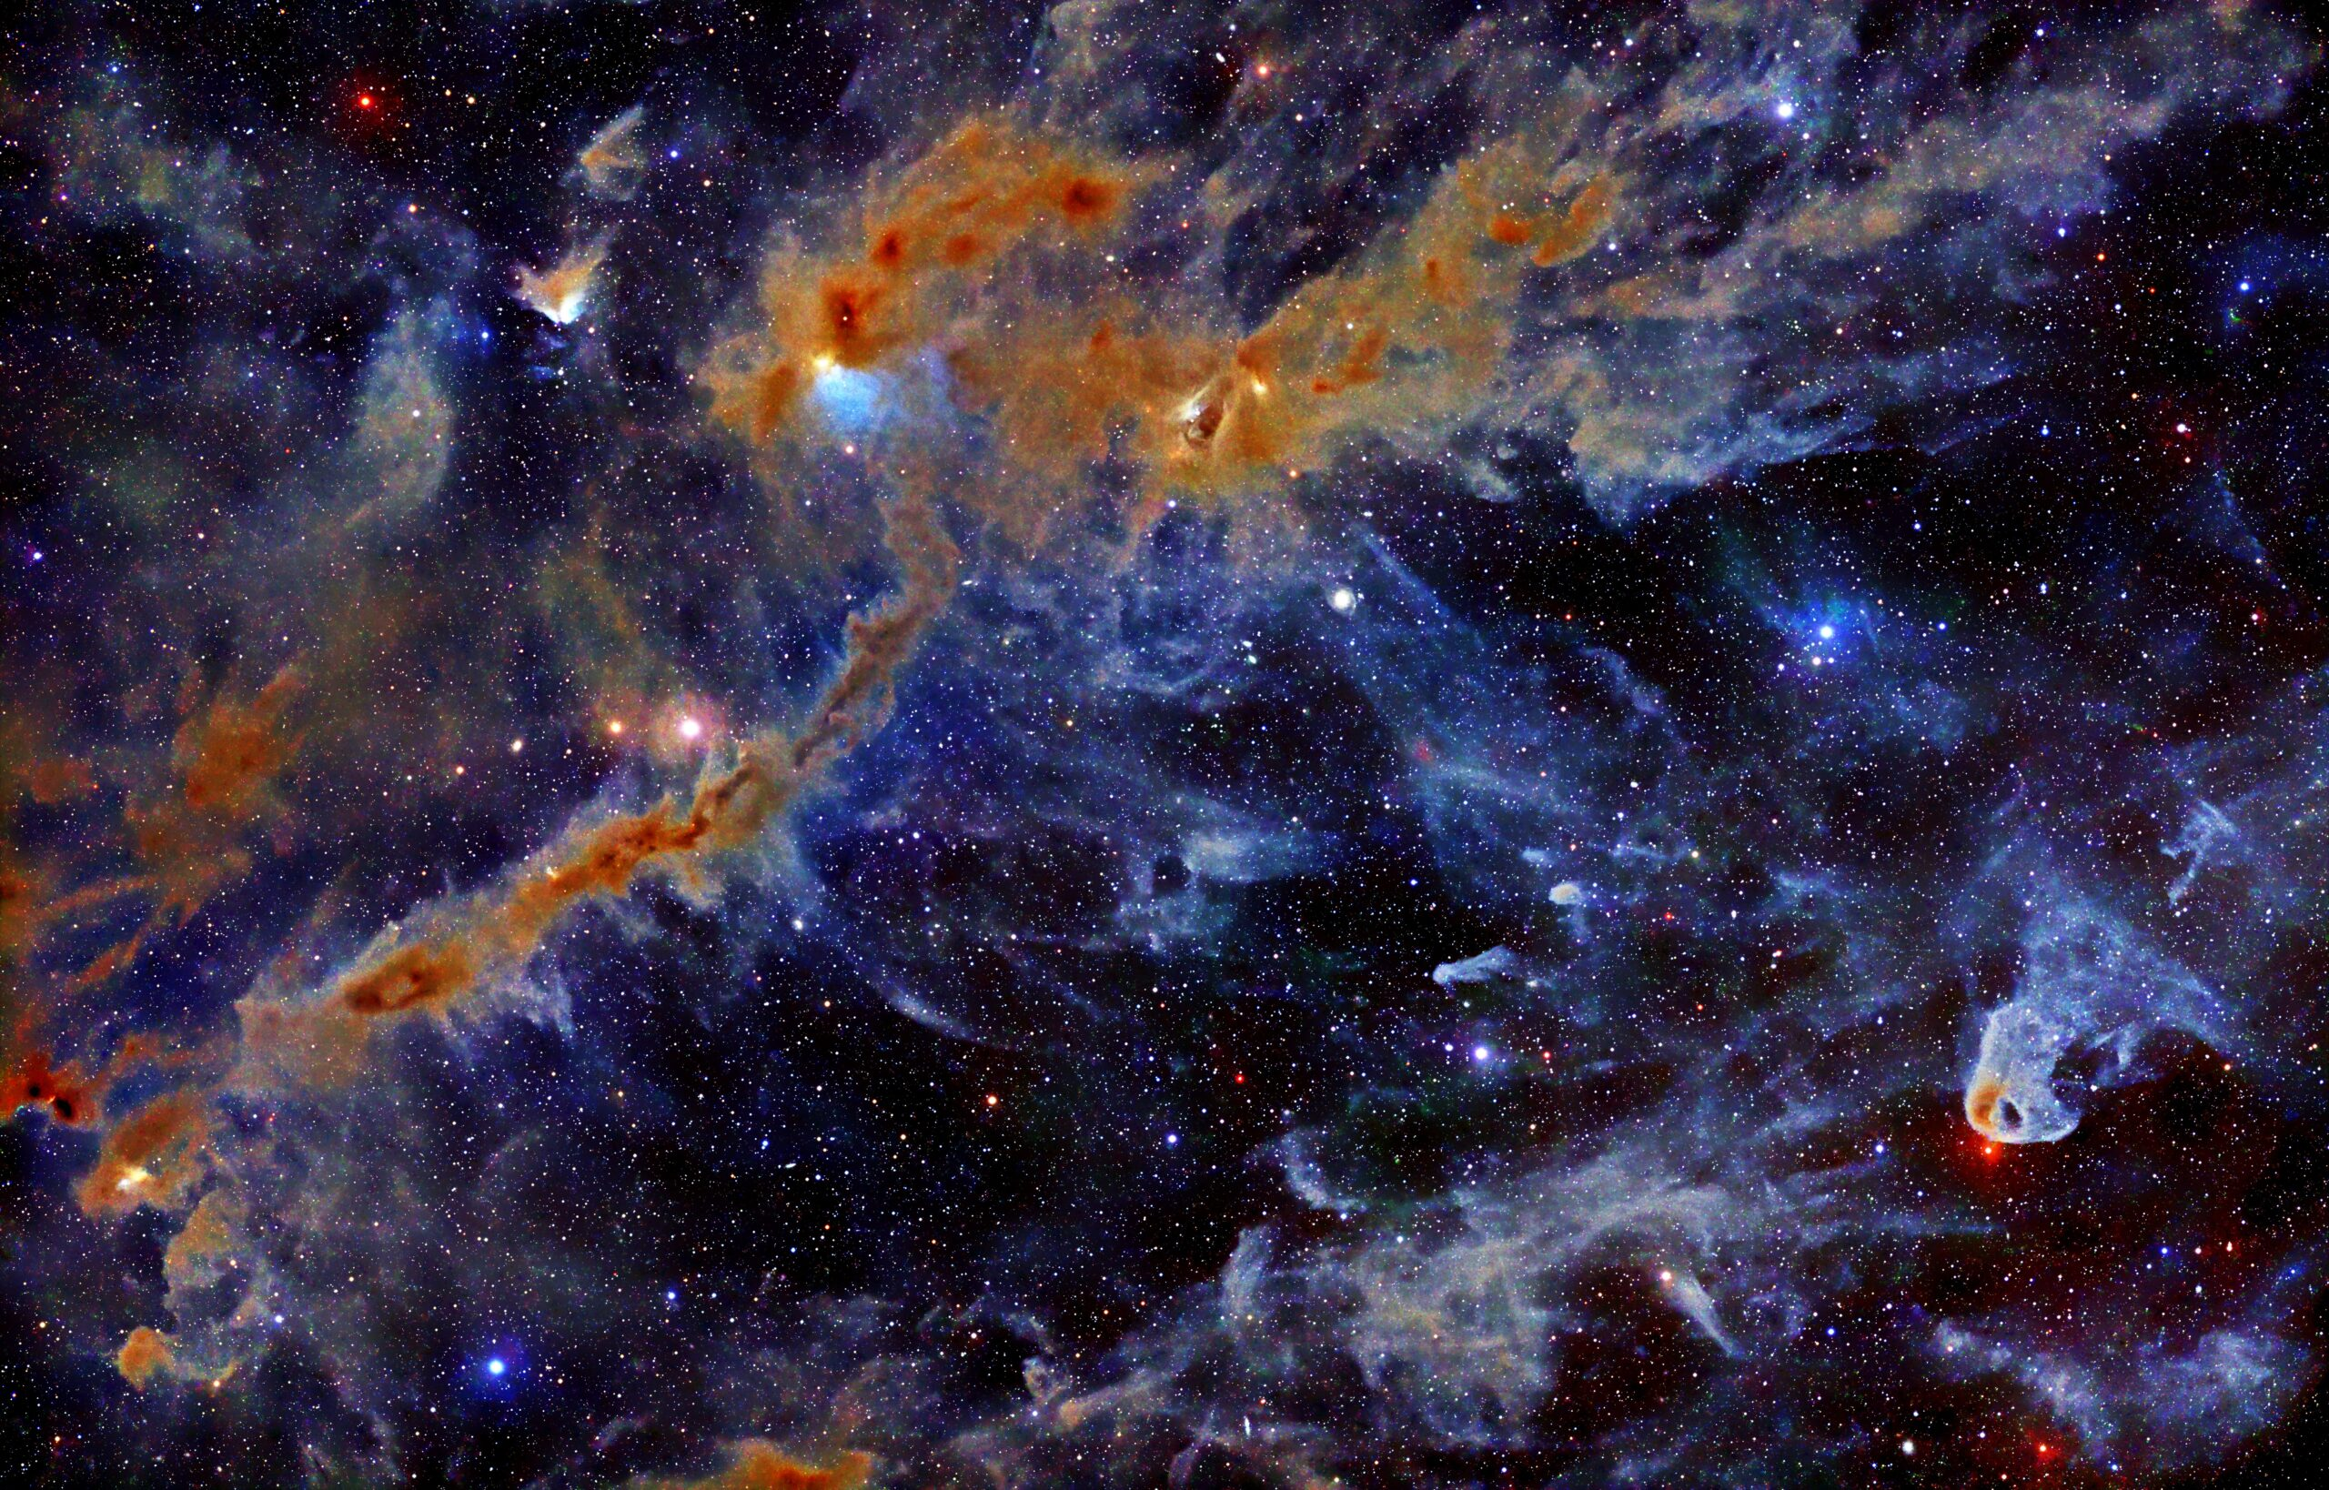
Thank you!
Credit: Stefan Ziegenbalg (http://www.simg.de/nebulae2/tau-00+02.html)

